Slide 1
Chapter 19
Categorical Outcomes: Chi-Square

Slide 2
Categorical Outcomes (1)
Sometimes we have data consisting of the frequency of cases falling into unique categories.
Examples:
  Number of people voting for different politicians.
  Numbers of students who pass or fail their degree in different subject areas.
  Number of patients or waiting list controls who are ‘free from diagnosis’ (or not) following a treatment.

Slide 3
Categorical Outcomes (2)
Analyzing two or more categorical variables.
  The mean of a categorical variable is meaningless.
    The numeric values you attach to different categories are arbitrary.
    The mean of those numeric values will depend on how many members each category has.
  Therefore, we analyze frequencies.

Slide 4
An Example: Dancing Cats and Dogs (1)
Question: Can animals be trained to line-dance with different rewards?
  Participants: 200 cats
Training
  The animal was trained using either food or affection, not both).
Dance
  The animal either learnt to line-dance or it did not.
Outcome:
  The number of animals (frequency) that could dance or not in each reward condition.
We can tabulate these frequencies in a contingency table.

Slide 5
A Contingency Table
 |  | Training
 |  | Food as reward | Affection as reward | Total
Could they dance? | Yes | 28 | 48 | 76
 | No | 10 | 114 | 124
 | Total | 38 | 162 | 200

Slide 6
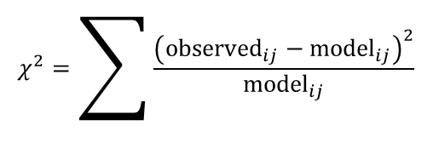
Pearson’s Chi-Square Test (1 of 3)
Use to see whether there’s a relationship between two categorical variables.
  Compares the frequencies you observe in certain categories to the frequencies you might expect to get in those categories by chance.
The equation:
  i represents the rows in the contingency table and j represents the columns.
  The observed data are the frequencies the contingency table.
$$χ^{2}=\sum{\frac{{\left({\text{observed}}_{ij}−{\text{model}}_{ij}\right)}^{2}}{{\text{model}}_{ij}}}$$

Slide 7
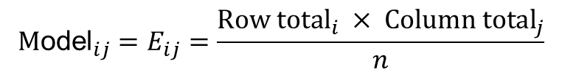
Pearson’s Chi-Square Test (2 of 3)
The ‘model’ is based on ‘expected frequencies’.
  Calculated for each of the cells in the contingency table.
  N is the total number of observations (in this case 200).
Test statistic
  Checked against a distribution with (r − 1)(c − 1) degrees of freedom.
  If significant then there is a significant association between the categorical variables in the population.
  The test distribution is approximate, so in small samples use Fisher’s exact test.
$${\text{M}\text{odel}}_{ij}=E_{ij}=\frac{{\text{Row} \text{total}}_{i} × {\text{Column} \text{total}}_{j}}{n}$$

Slide 8
The Data
 |  | Training
 |  | Food as reward | Affection as reward | Total
Could they dance? | Yes | 28 | 48 | 76
 | No | 10 | 114 | 124
 | Total | 38 | 162 | 200

Slide 9
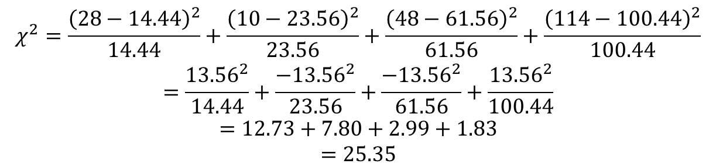
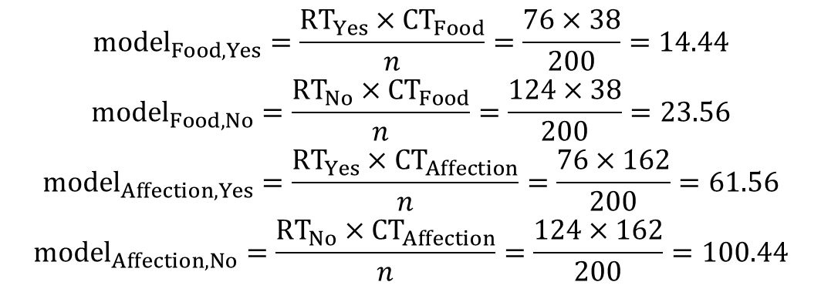
Pearson’s Chi-Square Test (3 of 3)
$$\begin{matrix}model_{Food,Yes}=\frac{RT_{Yes}×CT_{Food}}{n}=\frac{76×38}{200}=14.44 \\ model_{Food,No}=\frac{RT_{No}×CT_{Food}}{n}=\frac{124×38}{200}=23.56 \\ model_{Affection,Yes}=\frac{RT_{Yes}×CT_{Affection}}{n}=\frac{76×162}{200}=61.56 \\ model_{Affection,No}=\frac{RT_{No}×CT_{Affection}}{n}=\frac{124×162}{200}=100.44\end{matrix}$$
$$\begin{matrix}χ^{2}=\frac{{\left(28−14.44\right)}^{2}}{14.44}+\frac{{\left(10−23.56\right)}^{2}}{23.56}+\frac{{\left(48−61.56\right)}^{2}}{61.56}+\frac{{\left(114−100.44\right)}^{2}}{100.44} \\ =\frac{{13.56}^{2}}{14.44}+\frac{−{13.56}^{2}}{23.56}+\frac{−{13.56}^{2}}{61.56}+\frac{{13.56}^{2}}{100.44} \\ =12.73+7.80+2.99+1.83 \\ =25.35\end{matrix}$$

Slide 10
Likelihood Ratio Statistic (1 of 3)
An alternative to Pearson’s chi-square
Based on maximum-likelihood theory.
  Create a model for which the probability of obtaining the observed set of data is maximized.
  This model is compared to the probability of obtaining those data under the null hypothesis.
  The resulting statistic compares observed frequencies with those predicted by the model:
  i and j are the rows and columns of the contingency table and ln is the natural logarithm.

Slide 11
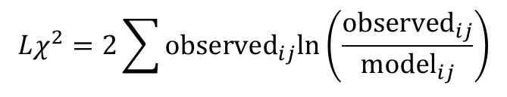
Likelihood Ratio Statistic (2 of 3)
$$Lχ^{2}=2{\sum{{\text{observed}}_{ij}\text{ln}}}^{\text{​}}\left(\frac{{\text{observed}}_{ij}}{{\text{model}}_{ij}}\right)$$
Test statistic
  Has a chi-square distribution with (r − 1)(c − 1) degrees of freedom.
  Preferred to the Pearson’s chi-square when samples are small.

Slide 12
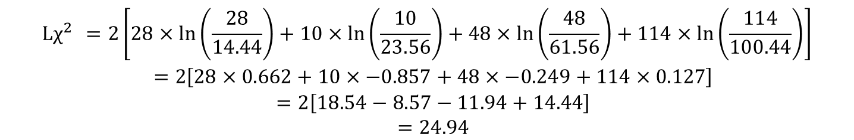
Likelihood Ratio Statistic (3 of 3)
$$\begin{matrix}Lχ^{2} =2\left[28×\text{ln}\left(\frac{28}{14.44}\right)+10×\text{ln}\left(\frac{10}{23.56}\right)+48×\text{ln}\left(\frac{48}{61.56}\right)+114×\text{ln}\left(\frac{114}{100.44}\right)\right] \\ =2\left[28×0.662+10×−0.857+48×−0.249+114×0.127\right] \\ =2\left[18.54−8.57−11.94+14.44\right] \\ =24.94\end{matrix}$$

Slide 13
Interpreting Chi-Square (1)
The test statistic gives an ‘overall’ result.
We can break this result down using standardized residuals.

Slide 14
Interpreting Chi-Square (2)
There are two important things about these standardized residuals:
  Standardized residuals have a direct relationship with the test statistic (they are a standardized version of the difference between observed and expected frequencies).
  They are z-scores (e.g. if the value lies outside of ±1.96 then it is significant at p < .05, etc.).
Effect size
  The odds ratio can be used as an effect size measure.

Slide 15
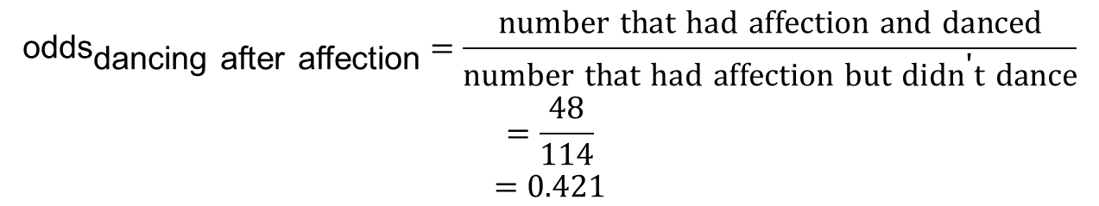
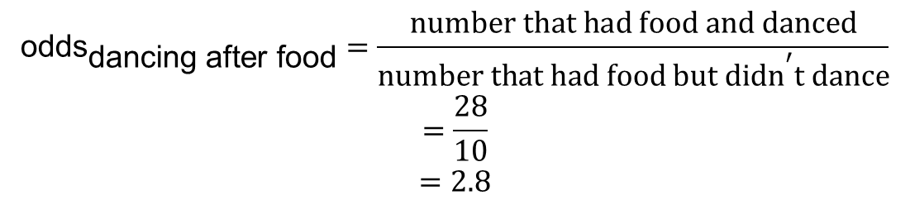
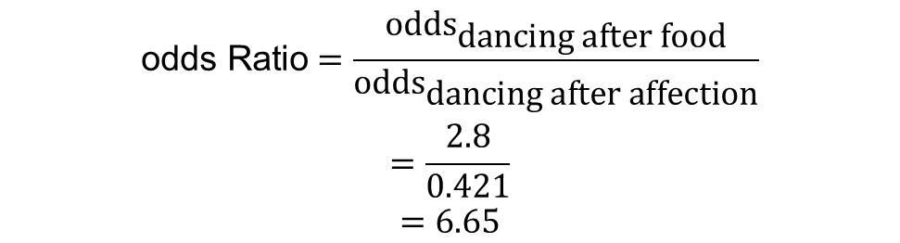
The Odds Ratio
$$\begin{matrix}{\text{odds}}_{\text{dancing} \text{after} \text{food}}=\frac{\text{number} \text{that} \text{had} \text{food} \text{and} \text{danced}}{{\text{number} \text{that} \text{had} \text{food} \text{but} \text{didn}}^{\text{′}}\text{t} \text{dance}} \\ =\frac{28}{10} \\ =2.8\end{matrix}$$
$$\begin{matrix}{\text{odds}}_{\text{dancing} \text{after} \text{affection}}=\frac{\text{number} \text{that} \text{had} \text{affection} \text{and} \text{danced}}{\text{number} \text{that} \text{had} \text{affection} \text{but} {\text{didn}}^{\text{′}}\text{t} \text{dance}} \\ =\frac{48}{114} \\ =0.421\end{matrix}$$
$$\begin{matrix}\text{odds} \text{Ratio}=\frac{{\text{odds}}_{\text{dancing} \text{after} \text{food}}}{{\text{odds}}_{\text{dancing} \text{after} \text{affection}}} \\ =\frac{2.8}{0.421} \\ =6.65\end{matrix}$$

Slide 16
Interpretation
There was a significant association between the type of training and whether or not cats would dance χ²(1) = 24.94. p < .001. Based on the odds ratio, the odds of cats dancing were 6.65 times higher if they were trained with food than if trained with affection.

Slide 17
To Sum Up …
We approach categorical data in much the same way as any other kind of data:
  We fit a model, we calculate the deviation between our model and the observed data, and we use that to evaluate the model we’ve fitted.

